Slide 1
CS3210 Tut 2
Programming Models &
Performance of Parallel Systems
Slides yeeted from Sriram
Pace: 6-10 mins per question

Slide 2
Lab 2 Curiosities: 2 billion instructions?

Slide 3
2 billion Instructions?
perf stat -e fp_arith_inst_retired.scalar_single ./mm-seq 1000
Why did we see the number of instructions we saw?

Slide 4
2 billion Instructions?
perf stat -e fp_arith_inst_retired.scalar_single ./mm-seq 1000
Why did we see the number of instructions we saw?
for (i = 0; i < size; i++)
for (j = 0; j < size; j++)
for (k = 0; k < size; k++)
result.element[i][j] += a.element[i][k] * b.element[k][j];

Slide 5
2 billion Instructions?
perf stat -e fp_arith_inst_retired.scalar_single ./mm-seq 1000
Why did we see the number of instructions we saw?
for (i = 0; i < size; i++)
for (j = 0; j < size; j++)
for (k = 0; k < size; k++)
result.element[i][j] += a.element[i][k] * b.element[k][j];
One sum and one mul per result over 1000x1000 result elements (2 billion fp ops). So why are there 2 billion +1 instructions?

Slide 6
2 billion Instructions?
So why are there 2 billion +1 instructions?
fprintf(stderr, "Matrix multiplication took %1.2f seconds\n",
((float)(after - before)) / 1000000000);
Perf is reliable and consistent*!! :)
*provided that perf does not subsample and your program does not have indeterministic branching

Slide 7
Lab 1 feedback

Slide 8
Common Issue 1: Longer critical sections
Do:
LOCK(m) Minimal work… UNLOCK(m)
Do not:
LOCK(m) rand().. other things that costs cycles unnecessarily UNLOCK(m)

Slide 9
Common Issue 2: Shmget copy paste
Do: // I want to store a and b in shared memory struct shm_data { int a; int b; } data = shmget… (sizeof(struct shm_data))
Fewer shm regions, better caching, etc
Do not: // I want to store a and b int* a = shmget… int* b = shmget… // or, manually index into shm: shm = shmget…; shm[0] = 5…

Slide 10
Printf galore:
Do not:
LOCK(m) printf("Produced item %d\n", thing); // do other things UNLOCK(m)
Printing stuff (especially in the critical section) can waste cycles.
Minimize the amount of IO in your program before benchmarking!
Notes:
ssh aeon
cd CS3210/Lab1
time ./threads_print
time ./threads

Slide 11
Tip: -D_DEBUG flag
In your code:
#ifdef _DEBUG printf("This program is compiled with -D_DEBUG!"); #endif printf("Hello world!");
Specify in your compilation command/Makefile to compile with _DEBUG flag:
g++ -D_DEBUG my_code.cpp -o my_program
Will print both statements!

Slide 12
Debugging Tips
Use valgrind --tool=helgrind to check for concurrency bugs
Other helpful ones like g++ -fsanitize=thread or -fsanitize=address
Maybe try compiling with clang++ too, it may produce different warnings :)
Always measure if possible, Google relentlessly! Many performance hypotheses can be tested.

Slide 13
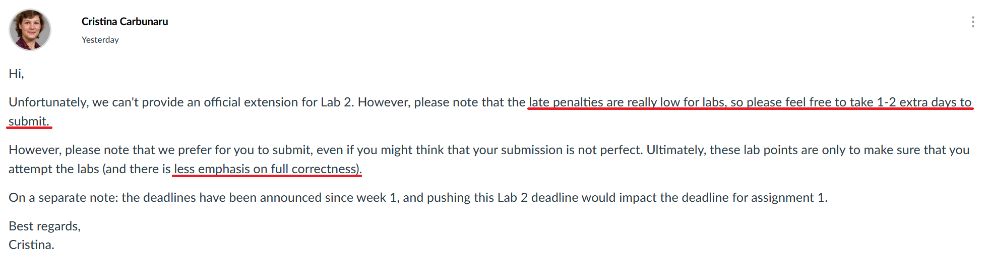
RE: late submissions

Slide 14
Tutorial time!

Slide 15
Question 1: Task Parallelism

Slide 16
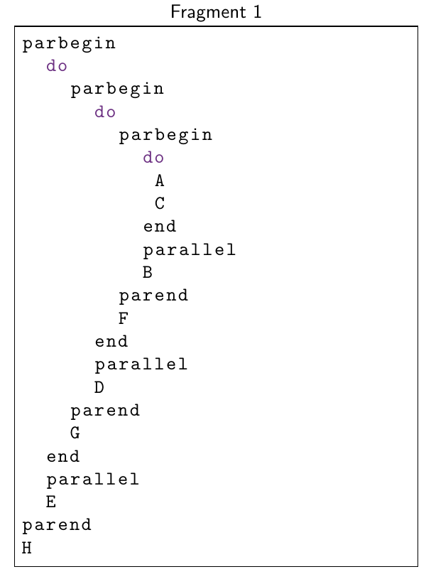
Question 1(a): Task Dependence Graphs
What on earth is this about?
vim q1.c
./q1

Slide 17
Question 1(a): Task Dependence Graphs
Let's find the dependencies!
Rules:
X Y → X and Y are sequentially executed
X parallel Y → X and Y are executed in parallel
parend → All tasks must complete before moving on

Slide 18
Question 1(a): Task Dependence Graphs
Let's find the dependencies!
A
C
B
F
D
E
G
H

Slide 19
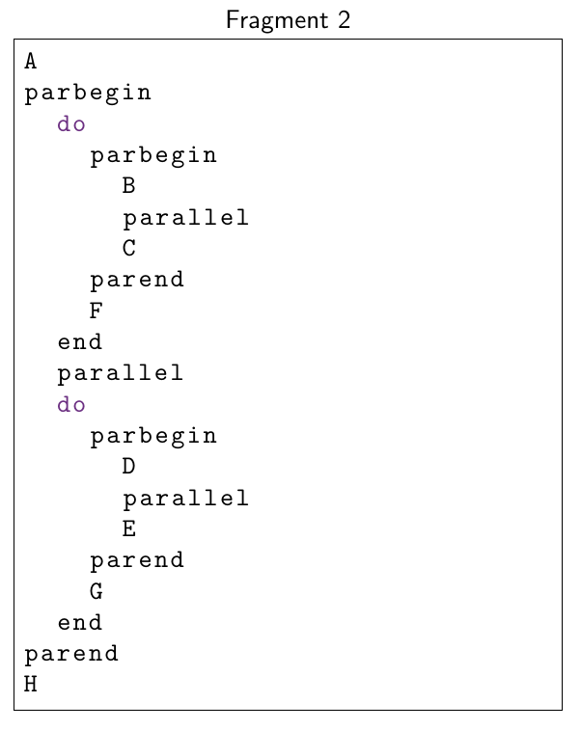
Question 1(a): Task Dependence Graphs
Fragment 2 Dependencies:
A
B
C
D
E
F
G
G

Slide 20
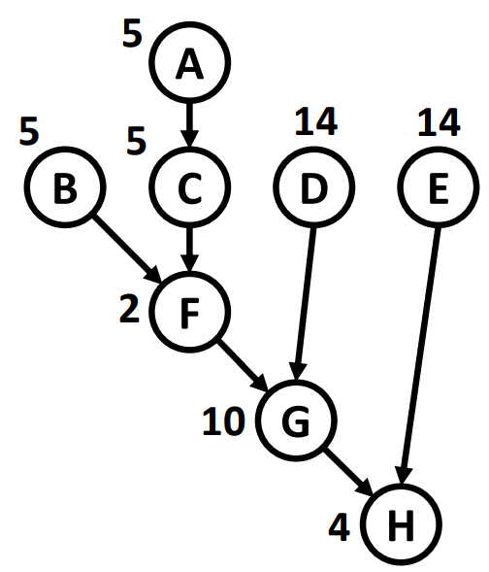
Q1 (b): Amount of Concurrency
Plot the concurrency for Fragment 1

Slide 21
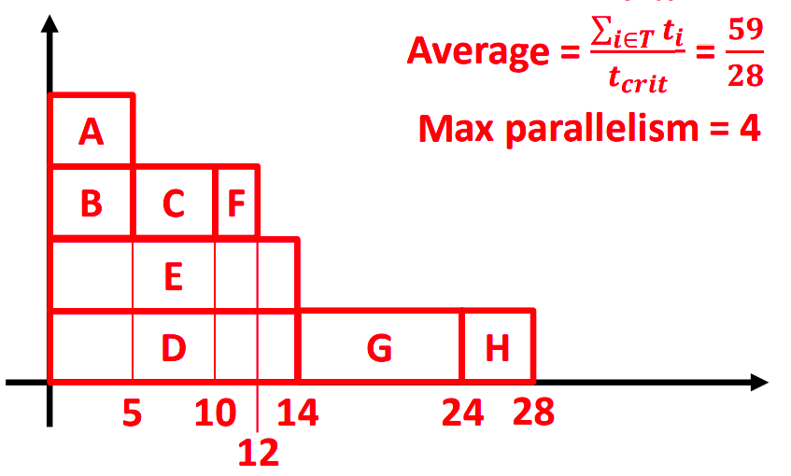
Q1 (b): Amount of Concurrency
Plot the concurrency for Fragment 1
Can you determine the critical path length? i.e. Minimum execution time given sufficient processes for max parallelism
Can you then determine the average concurrency?

Slide 22
Q1 (b): Amount of Concurrency
Critical path length? 28
Average Concurrency? → Sum of work / 28 = 59/28 = 2.10
Max Concurrency? 4
28

Slide 23
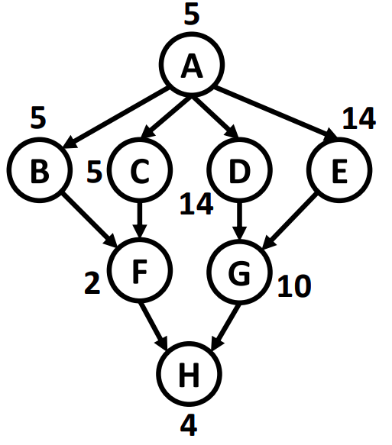
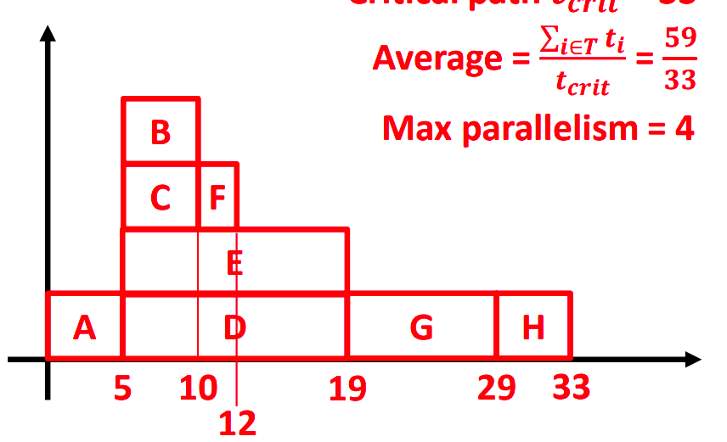
Q1 (b): Amount of Concurrency
Critical path length?
Average Concurrency?
Max Concurrency?

Slide 24
Q1 (b): Amount of Concurrency
Critical path length? 33
Average Concurrency? → Sum of work / 33 = 59/33 = 1.78
Max Concurrency? 4

Slide 25
Q1 (c): Speedup
What is the speedup of this program given infinite resources?

Slide 26
Q1 (c): Speedup
What is the speedup of this program given infinite resources?
Sequental implementation = 59 units
Parallel: finishes in 28 time units
Length of the critical path!!
Speedup = 59/28 = 2.10
(== avg deg of concurrency)
Fragment 2's speedup is 1.78 == its avg deg of concurrency

Slide 27
Q1 (d): Speedup
What if we have only 2 processing units? What is the speedup?

Slide 28
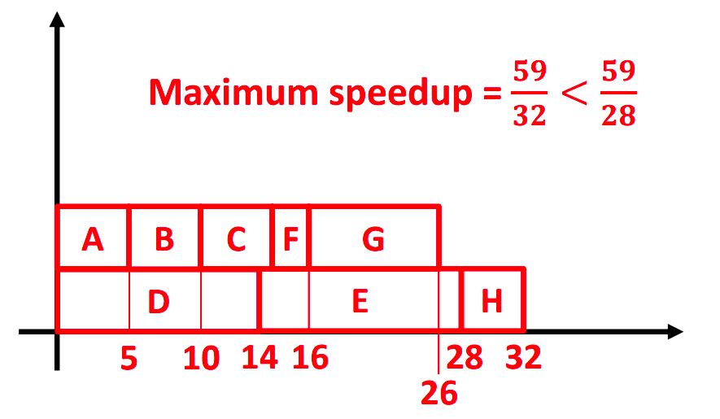
Q1 (d): Speedup
What if we have only 2 processing units? What is the speedup?
Have to draw it out, no easy solution

Slide 29
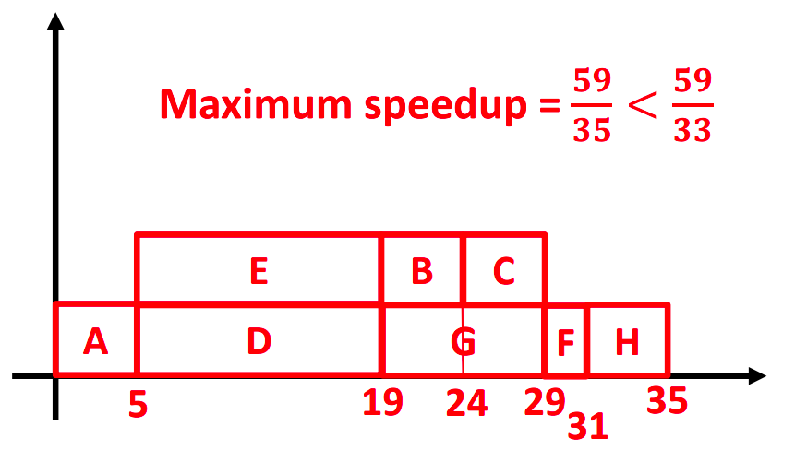
Q1 (d): Speedup
What if we have only 2 processing units? What is the speedup?
Have to draw it out, no easy solution

Slide 30
Why does this question matter?
Helps you to understand how to design your parallel programs!
Your program is only as strong as its weakest link!
Parallel tasks should be as independent as possible
They should have the shortest critical path possible (dependency chain should be minimized)

Slide 31
Question 2: User CPU Time

Slide 32
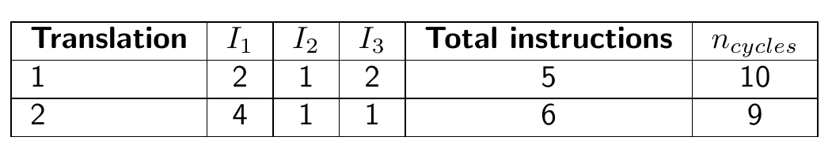
Question 2: Cycles Per Instruction
Cycles per instruction (CPI) for each instr: I₁ = 1, I₂ = 2, I₃ = 3
What is the average CPI for the translation of both programs?

Slide 33
Question 2: Cycles Per Instruction
Cycles per instruction (CPI) for each instr: I₁ = 1, I₂ = 2, I₃ = 3
What is the average CPI for the translation of both programs?
Relatively trivial: no. of cycles / no. of instructions
1st program: 10 / 5 = 2.0 (10 = 2*1 + 1*2 + 2*3)
2nd program: 9 / 6 = 1.5

Slide 34
Why does this question matter?
Not all instructions are created equal!
i.e. no. of instructions is not a good comparative metric for time taken
Let's try…
vim intadd.c
vim floatadd.c
perf stat -e cycles,instructions -- ./intadd
perf stat -e cycles,instructions -- ./floatadd
https://godbolt.org/z/3MobeMxbP

Slide 35
Question 3: MIPS

Slide 36
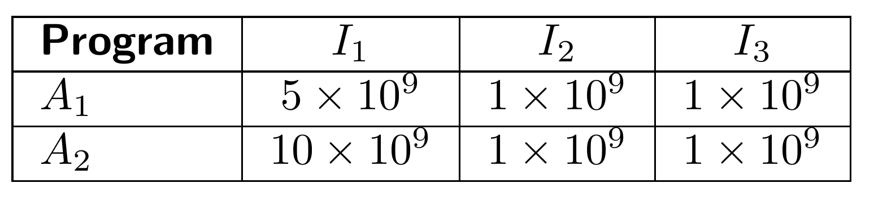
Question 3: MIPS
Cycles per instruction (CPI) for each instr: I₁ = 1, I₂ = 2, I₃ = 3
2 GHz (2 x 10⁹) clock rate
Different composition of instructions in each program
What is the relationship between time taken (to complete the program) and MIPS in this qn?

Slide 37
Question 3: MIPS
Cycles per instruction (CPI) for each instr: I₁ = 1, I₂ = 2, I₃ = 3
2 GHz (2 x 10⁹) clock rate
How long does each program take?
Time for A₁ = (Cycles / Clock speed) = (5 + (1 x 2) + (1 x 3)) x 109 / (2 x 109) = 5s
Time for A₂ = (Cycles / Clock speed) = (10 + (1 x 2) + (1 x 3)) x 109 / (2 x 109) = 7.5s
What is the MIPS for each program?
MIPS for A₁ = (MillionInstrs / Time) = ((5 + 1 + 1) x 10⁹ / 106) / 5 = 1400 MIPS
MIPS for A₂ = (MillionInstrs / Time) = ((10 + 1 + 1) x 10⁹ / 106) / 7.5 = 1600 MIPS
What can we conclude?

Slide 38
“MIPS is like a real estate agent determining how much a building is worth by measuring the weight of a rubber chicken.” (Brendan, StackOverflow)

Slide 39
Why does this question matter?
Don't be fooled by marketing!
You are now educated in parallel computing performance :)

Slide 40
Question 4: Speedup

Slide 41

Question 4: Speedup
For these questions: we could use the laws directly (feel free in the exam, faster)
But in this tutorial: let's understand what we're doing from first principles!
Each instruction takes 2 cycles on a 1 GHz processor

Slide 42
Question 4: Speedup
For N = 100, what is the speedup for 10 and 100 processors?
Strategy (using basic logic): find sequential time, find parallel times
Sequential time: ((100 + 100²) x 2) / 10⁹ = 20200 ns
Par time (p=10): ((100 + 100²/10) x 2) / 10⁹ = 2200 ns (9.18x speedup)
Par time (p=100): ((100 + 100²/100) x 2) / 10⁹ = 400 ns (50.6x speedup)
If we have infinite resources, the parallel section can be approximated to 0 instructions running serially
Par time (p=∞): ((100 + 0) x 2) / 10⁹ = 200 ns (101x speedup)
Each instruction takes 2 cycles on a 1 GHz processor

Slide 43
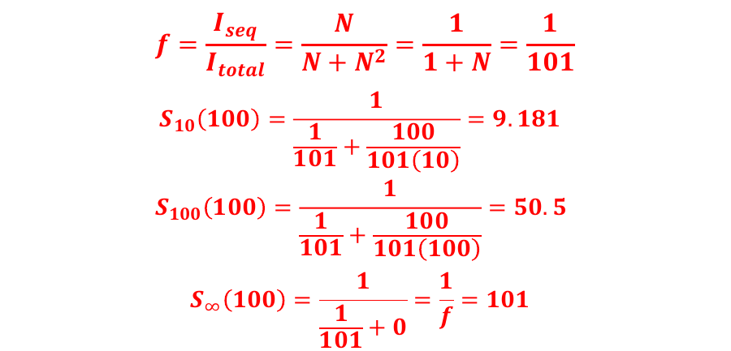
Question 4: Speedup
Note: This is identical from direct application of Amhdal's law, but the basics are simpler to understand for now!
Recap:
f = ratio of sequential execution time to total execution time
S₁₀ = Speedup achievable with 10 processors
Each instruction takes 2 cycles on a 1 GHz processor

Slide 44
Question 4: Speedup
Fixed time: N that can be solved with 10/100 processors?
Sequential time (p=1): ((100 + 100²) x 2) / 109 = 20200 ns
For 10 processors, find N:
((N + N²/10) x 2) / 10⁹ = 20200 ns ⇒ N = 312
“Gustafson speedup”: (Sequential time for N = 312 / Parallel time for N = 312)
For 100 processors, find N:
((N + N²/100) x 2) / 10⁹ = 20200 ns ⇒ N = 956
You don’t need to “stick to the law” to solve these problems!
Each instruction takes 2 cycles on a 1 GHz processor
Notes:
(312+312^2)*2 = seq runtime in ns for N = 312
(956+956^2)*2 = seq runtime in ns for N = 312

Slide 45
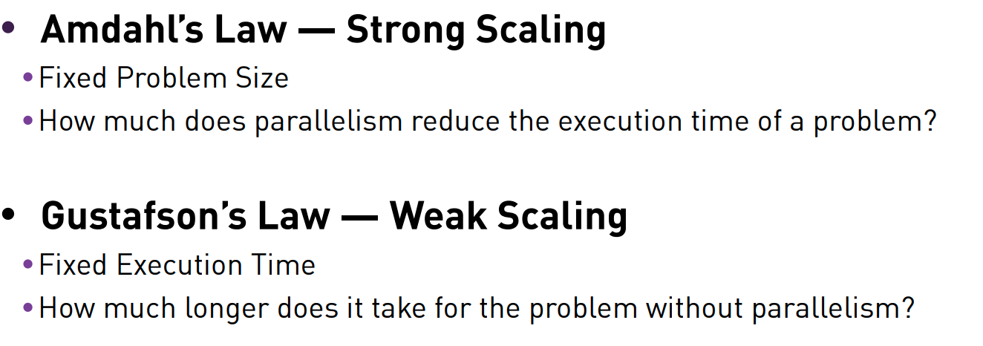
Why does this question matter?
If you have a fixed-sized problem to solve OR you have a constant sequential fraction with increasing problem size
Amdahl’s law applies: speedup limited by the sequential fraction
If you have a problem size that can be varied AND your sequential fraction does not scale as much with the problem
Gustafson’s law applies: you can solve larger problems with more speedup!
Let’s see this in action…

Slide 46
Amdahl’s law vs Gustafson’s Law
Fixed problem size
vim performance.c
time OMP_NUM_THREADS=1 ./performance
time OMP_NUM_THREADS=10 ./performance
time OMP_NUM_THREADS=1000 ./performance
You may already seen this in Lab 2 Ex7…

Slide 47
Question 5: Parallel Programming Models

Slide 48
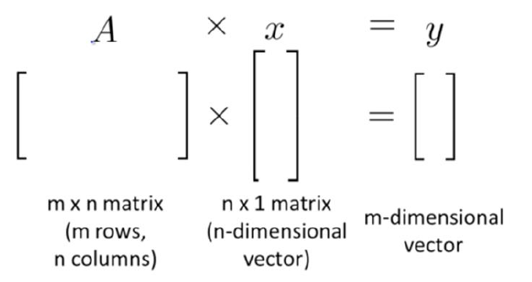
Question 5: Parallel Programming Models
Data or task parallelism?

Slide 49
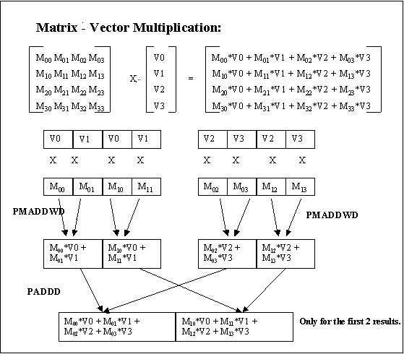
Question 5: Parallel Programming Models
Data Parallelism
We want to use SIMD (Flynn's Taxonomy) for this!
Yes, MIMD is superset of SIMD
Teaching point here is the idea of SIMD instructions
Let's see what this looks like in real code…

Slide 50
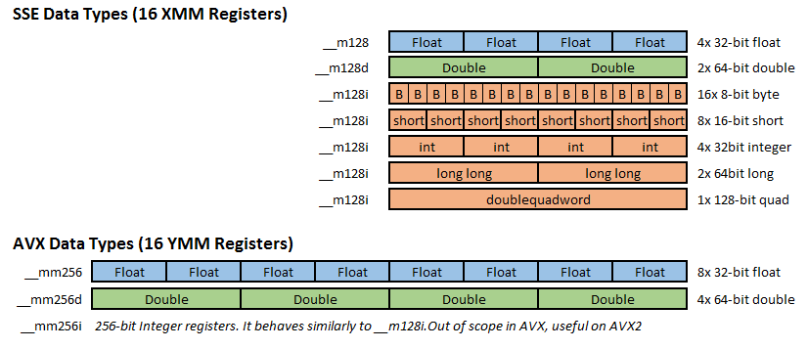
Q5: Real SIMD code
vim simd.cpp
Don't worry, I can't write code that uses AVX instructions. (You don't have to learn how to write this too.)
To compile with AVX support: g++ -mavx2 simd.cpp -o simd
./simd

Slide 51
Question 5: Parallel Programming Models
What kind of parallel programming pattern (disregarding SIMD) would be best for this?
Fork-join
Parbegin-parend
Master-worker
Task pool
Pipelining
Producer-consumer

Slide 52
Question 5: Parallel Programming Models
What kind of parallel programming pattern would be best for this?
Fork-join / Parbegin-parend
We don’t need the complexity of fork-join - leads to very spaghetti code
Parbegin/end is arguable since that is literally OpenMP
Master-worker
Best here: we want relatively simple and homogeneous (same amount of work) worker threads, and a master thread to organize them
Task pool
Not as good as master-worker here: tasks are usually for heterogeneous tasks or those that finish at very different times
Pipelining: better for task parallelism, this is data parallel, single task type
Producer-consumer: does not fit into this model as nothing is “produced”

Slide 53
Why does this question matter?
Thinking of the right pattern allows you to use the right tools
Non-data-parallel-like problem: Don't use GPGPU computation
Parbegin/end: good for OpenMP
Many more!

Slide 54
Question 6: 2020 Midterms Q1

Slide 55

Question 6: 2020 Midterms Q1
You are parallelizing a backend web server
It runs on a shared memory machine
Discuss about
task vs data parallelism
what pattern to use
Request for each client run in this order
read
socket
process
write

Slide 56
Question 6: 2020 Midterms Q1
What kind of parallelism? [Task/Data parallelism]
read
socket
process
write
Assume that read/write/process time is all very similar

Slide 57
Question 6: 2020 Midterms Q1
What kind of parallelism?
Task parallelism: each stage is a task
Data parallelism may be accepted if request = task AND requests assumed to arrive at same time
What pattern to use?
read
socket
process
write
Assume that read/write/process time is all very similar

Slide 58
Question 6: 2020 Midterms Q1
What kind of parallelism?
Task parallelism: each stage is a task
Data parallelism may be accepted if request = task AND requests assumed to arrive at same time
What pattern to use?
Best: pipelining - best in cases where each stage takes similar time
read
socket
process
write
Assume that read/write/process time is all very similar

Slide 59
Question 6: 2020 Midterms Q1
What kind of parallelism?
read
socket
process
write
Assume that read/write >> compute time

Slide 60
Question 6: 2020 Midterms Q1
What kind of parallelism?
Task parallelism: each stage is a task
What pattern to use?
Producer-consumer: producer reads from socket and processes, consumer writes back to the socket, #producers == #consumers
No pipelining: the stages are uneven!
read
socket
process
write
Assume that read/write >> compute time

Slide 61
Question 6: 2020 Midterms Q1
Similar to previous part: except for producer/consumer, we need more producers than consumers
read
socket
process
write
Assume that compute time >> read/write

Slide 62
Question 6: 2020 Midterms Q1
Assume task parallelism
What pattern do we use?
Task pool is perfect here: pool of tasks are ready for jobs and are assigned as necessary
If distributed memory: same answers, but need explicit communication.
rEaD
socket
proCesS
wRiTe
What if we don’t know how long anything takes? Or heavily varies?

Slide 63
Question 6: 2020 Midterms Q1
Distributed memory architecture?
Same answers, but need explicit communication.
Pipelining not feasible
rEaD
socket
proCesS
wRiTe
What if we don’t know how long anything takes? Or heavily varies?

Slide 64
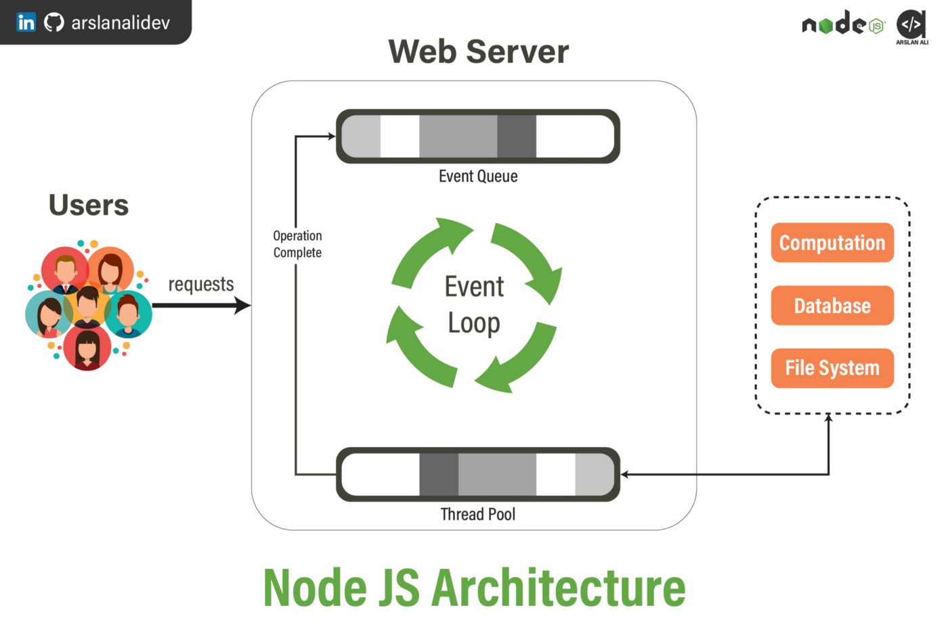
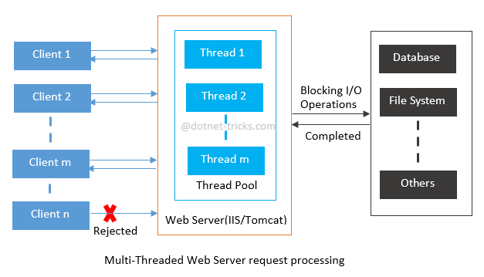
Why does this question matter?
Affects your entire system architecture and downstream programming patterns!

Slide 65
End of Tut 2
Slides are uploaded here after every session GDrive: drive.zhiheng.dev
Anonymous Feedback: feedback.zhiheng.dev
Reminder: Submit your Lab 2 by tomorrow 2pm!
Attendance

